Slide 2
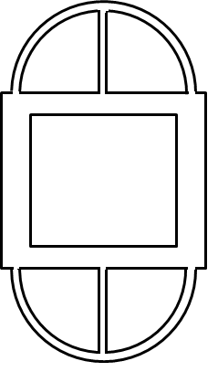
The cross section of the aluminum tube shown transmits a torsional moment of 5000lb. Let E=10Msi and μ=0.33. The section is symmetric with respect to the y and z axes. The 1.0in dimensions are between wall centerlines, and the center lines of the 0.25in vertical walls align with the centerlines of the ends of the circular walls. Determine the average shear stress in each wall and the angle of twist over the length of 24in.
0.125in
1.0in
0.25in
2.0in

